Slide 1


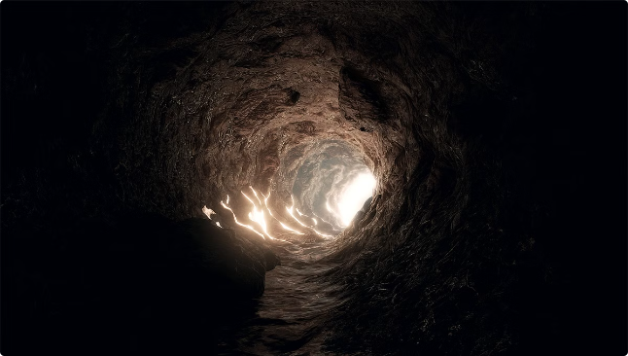

Wumpus World Game
The Wumpus World is a classic AI problem where an agent navigates a dangerous cave to find gold.
by kushrajsinh zala

Slide 2
Overview of the Wumpus World Game
The Cave
The Agent
Gameplay
The Wumpus World is a grid-based environment with various rooms, hazards, and a single Wumpus.
The agent's goal is to find the gold while avoiding the Wumpus, pits, and stench and breeze emanating from them.
The agent can move, shoot an arrow, and perceive its surroundings using sensory information.

Slide 3

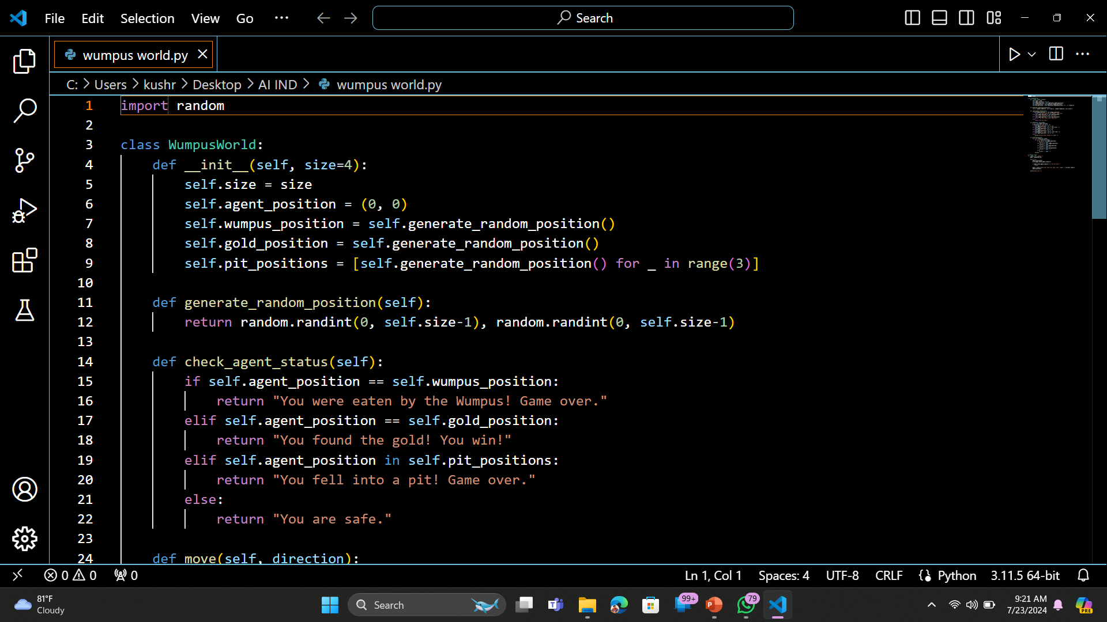
Implementing the Wumpus World Game in Python
Representing the Game World
Implementing the Agent
The agent's actions, perceptions, and decision-making can be implemented using Python functions and classes.
The game board can be represented as a 2D array, where each cell holds information about its state.
Game Logic
The game logic handles player actions, updates the game state, and determines game outcomes like winning or losing.

Slide 4

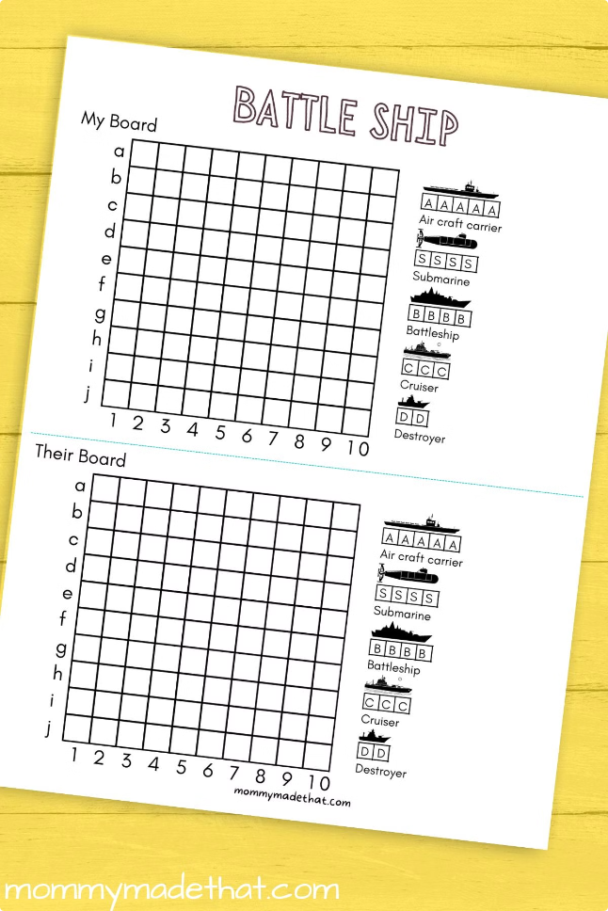
Representing the Game Board
Cell
Content
0,0
Agent
1,2
Wumpus
3,1
Pit
2,3
Gold

Slide 5
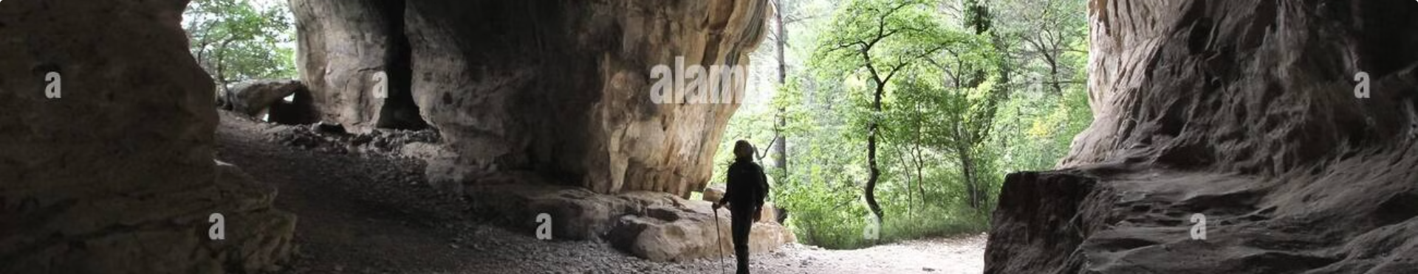



Handling Player Movement
Input
Validation
Update
The agent receives movement commands from the user (e.g., "go north").
The game checks if the movement is valid (e.g., not going out of bounds).
The agent's position on the game board is updated.

Slide 6


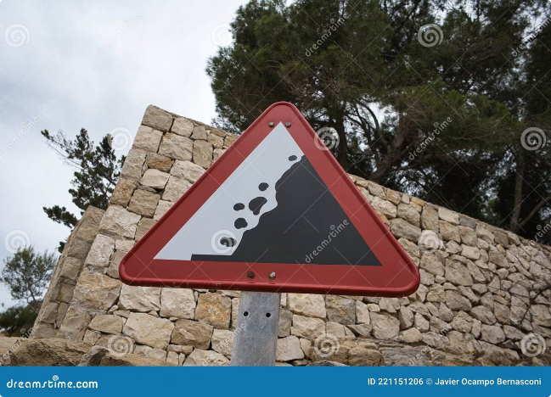


Detecting Hazards and Threats
Stench
Indicates the presence of the Wumpus in an adjacent room.
Breeze
Indicates the presence of a pit in an adjacent room.
Glitter
Indicates the presence of gold in the current room.

Slide 7


Conclusion and Demonstration
By implementing the Wumpus World game in Python, we can explore AI concepts like knowledge representation, reasoning, and decision-making.

